Slide 1
Community Analysis: Graphs of Top 100 Words by Frequency from Prominent Twitter Users
Alex Nazareth
Ryerson University

Slide 2

Gephi Procedure
ForceAtlas2 layout algorithm settings (run until it appears to settle)
Scaling = 10 and Gravity = 20
Dissuade Hubs = true
LinLog mode = true
Prevent Overlap = true (only briefly at the end for performance reasons)
Remaining settings left as default
Calculate modularity statistic and partition node colours
Set node size based on degree
Add node labels
Run LabelAdjust, along with some manual visual tweaks

Slide 3

@JustinTrudeau January 2020
Potential Community Meanings
Orange
g
Lime green
g
Dark green
g
g
Pink
g
g
J
F
M
A
M
J
+

Slide 4
@JustinTrudeau February 2020
Potential Community Meanings
Orange
Canada Child Benefit
Campaign promise to reduce child poverty
Lime green
g
Dark green
g
Blue
g
Pink
g
J
F
M
A
M
J
+

Slide 5
@JustinTrudeau March 2020
Potential Community Meanings
Orange
g
Lime green
g
Blue
g
Pink
g
J
F
M
A
M
J
+

Slide 6
@JustinTrudeau April 2020
Potential Community Meanings
Orange
g
Lime green
g
Blue
g
Pink
g
J
F
M
A
M
J
+

Slide 7
@JustinTrudeau May 2020
Potential Community Meanings
Orange
g
Lime green
g
Blue
g
Pink
g
J
F
M
A
M
J
+

Slide 8
@JustinTrudeau June 2020
Potential Community Meanings
Orange
g
Lime green
g
Blue
g
Pink
g
J
F
M
A
M
J
+

Slide 9
@JustinTrudeau June YTD 2020
Potential Community Meanings
Orange
g
Lime green
g
Blue
g
Pink
g
J
F
M
A
M
J
+

Slide 10

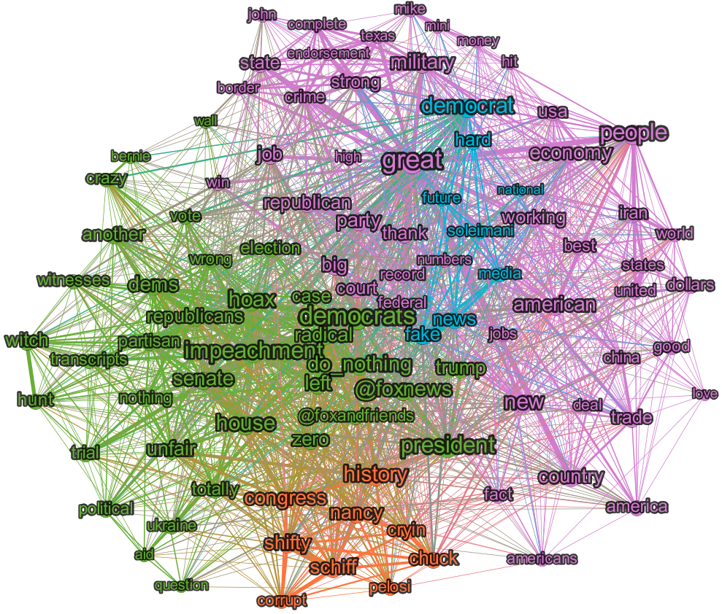
@realDonaldTrump January 2020
Potential Community Meanings
Orange
Democrat scheming
Lime green
Impeachment “witch hunt”
Blue
Soleimani assassination
Pink
Policy stuff
Republican endorsements
J
F
M
A
M
J
+

Slide 11
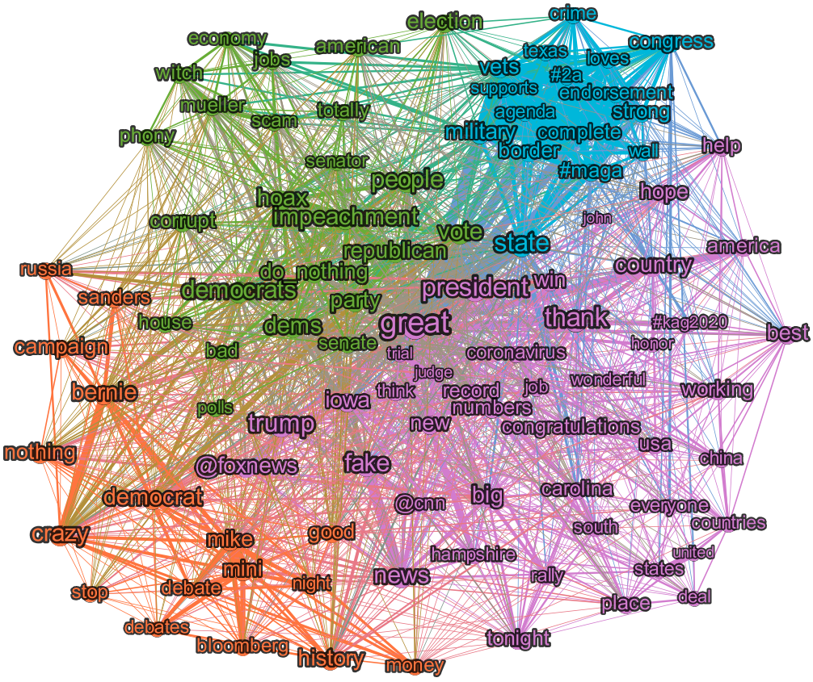
@realDonaldTrump February 2020
Potential Community Meanings
Orange
Democrat primaries
Lime green
Impeachment
Blue
Republican endorsements
Pink
Primaries
Policy
COVID-19 under control
J
F
M
A
M
J
+

Slide 12
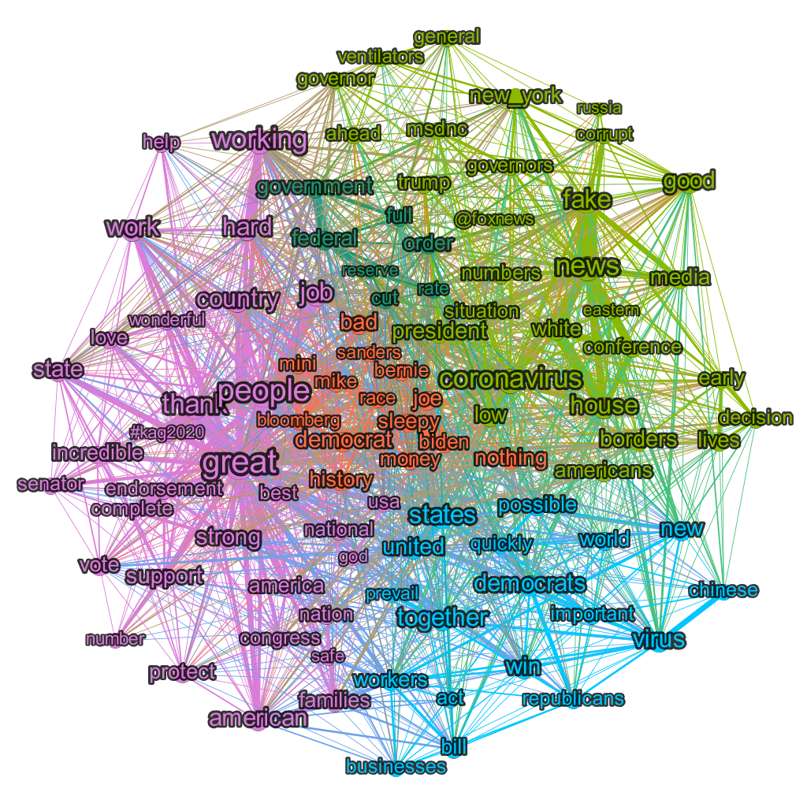
@realDonaldTrump March 2020
Potential Community Meanings
Orange
Democrat primaries
Lime green
Fake COVID-19 news
Blue
Fight against COVID-19
Pink
Republican primaries
J
F
M
A
M
J
+

Slide 13
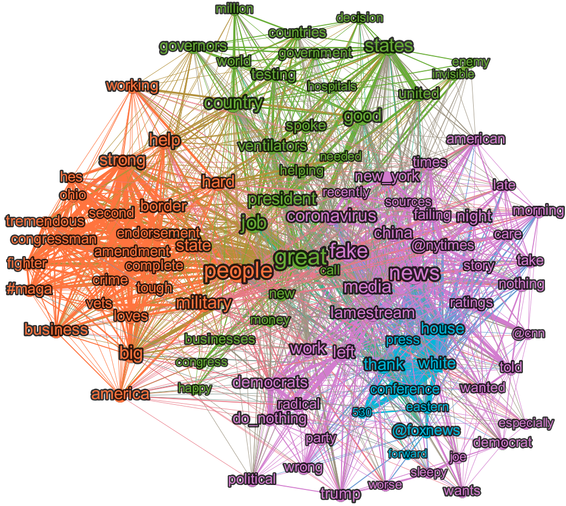
@realDonaldTrump April 2020
Potential Community Meanings
Orange
Republican primaries
Lime green
COVID-19 response
Blue
White house daily presser
Pink
Fake news (esp. about COVID-19)
J
F
M
A
M
J
+

Slide 14
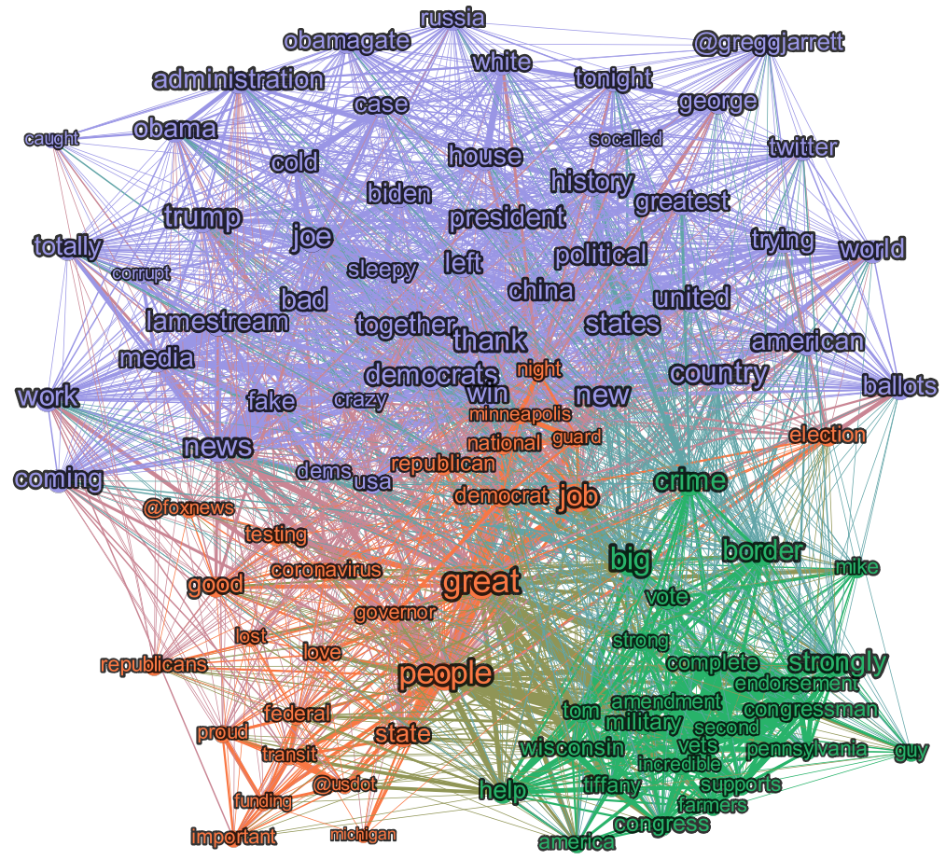
@realDonaldTrump May 2020
Potential Community Meanings
Orange
Policy (transit funding)
Green
Republican primaries
Lavender
Fake news
J
F
M
A
M
J
+

Slide 15
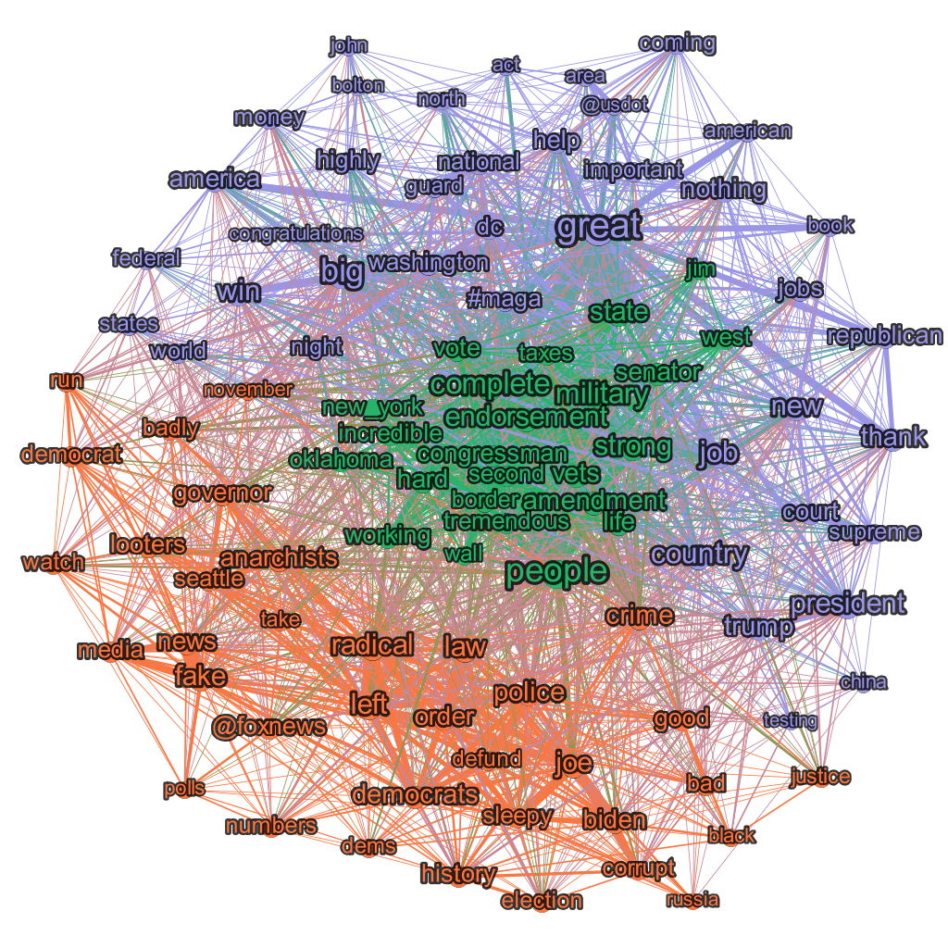
@realDonaldTrump June 2020
Potential Community Meanings
Orange
Fake news
Democrat stuff, protests
Green
Republican endorsements
Lavender
Policy
J
F
M
A
M
J
+

Slide 16
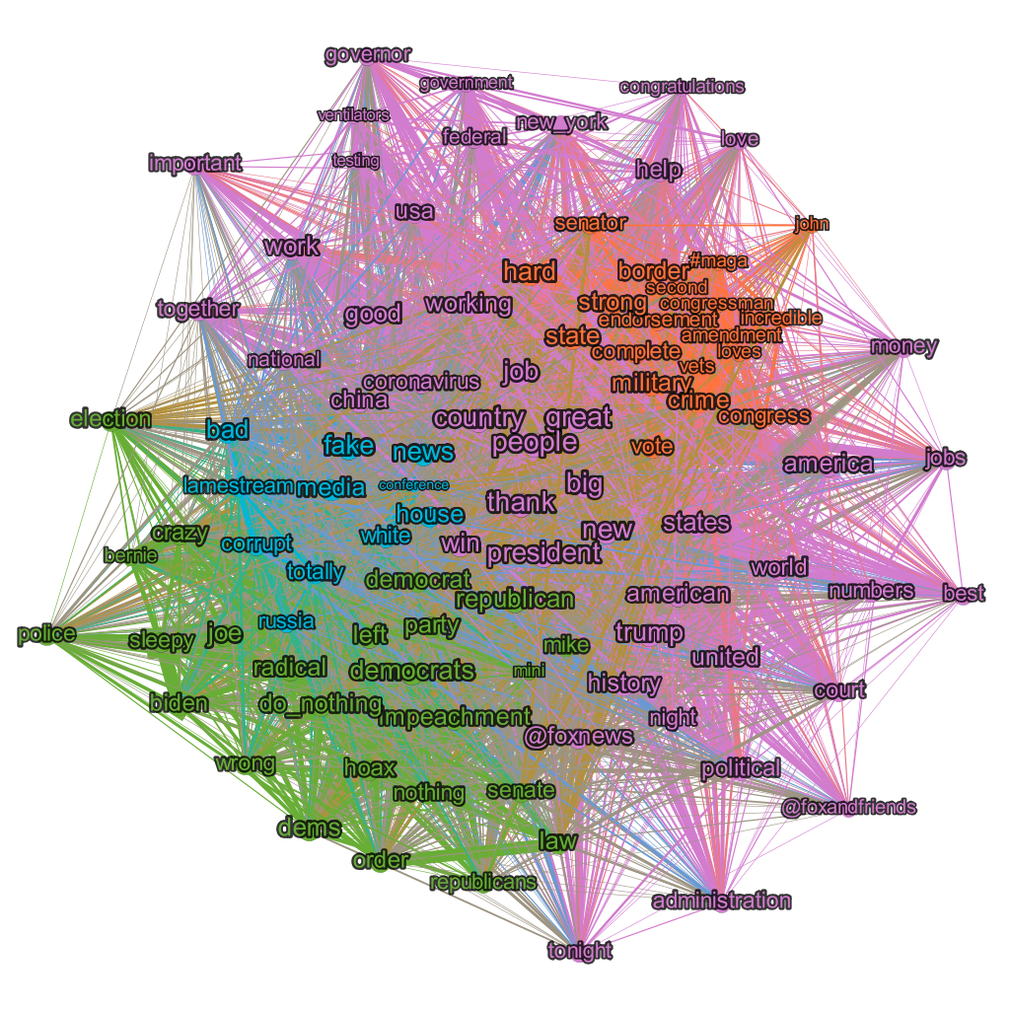
@realDonaldTrump June YTD 2020
Potential Community Meanings
Orange
Republican endorsements
Lime green
Democrat stuff (impeachment)
Blue
Fake news
Daily news conferences
Pink
Policy
Handling COVID-19
J
F
M
A
M
J
+

